Slide 1
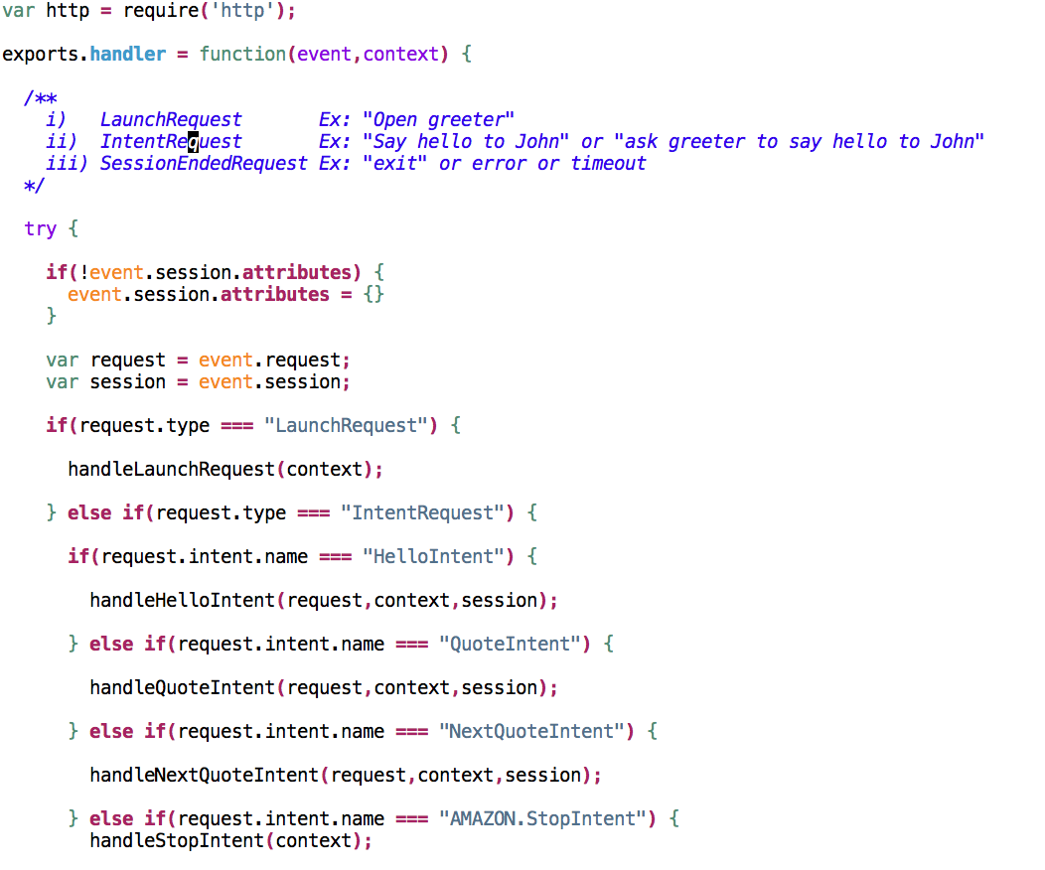
COMPREHENSIVE GUIDE TO ALEXA SKILL DEVELOPMENT
ALEXA SKILLS

Slide 2
COURSE OVERVIEW

Slide 3
Section -1 Getting started
Course Overview
Introduction to Amazon Echo, Alexa Voice Service (AVS) and Alexa Skill Kit (ASK)

Slide 4
Section -2 Greetings skill using AWS Lambda function
Skill goal and setup
Request generation
AWS Lambda function setup
Node.js quick tutorial
Coding, deploying and testing
Local environment, AWS CLI setup and automation
Adding more functionality
APIs
SSML
Sessions and built-in intents
Including Card
Debugging
Testing using Mocha framework

Slide 5
Section -3 Greetings skill using Web service as endpoint
Introduction
Coding (Python and Flask web framework)
Deploying from Local web server
Hosting the skill on Heroku
Testing using python unittest
Requirements of Web service and FLASK-ASK
Greetings skill using FLASK-ASK and deploying to Heroku

Slide 6
Section -4 Food Nutrition Lookup skill development
Introduction
Setup
Coding, testing and deploying
Publishing process
Certification requirements and fixes
Improvements

Slide 7
Section -5 Email Checker skill – Account linking feature
Account linking introduction
Gmail APIs and Google API console setup
Skill setup
Coding, testing and deploying
Voice password introduction and AWS DynamoDB setup
Adding voice password functionality and testing
Adding Forgot pin functionality
Conclusion

Slide 8
AMAZON ECHO ALEXA VOICE SERVICE AND ALEXA SKILL KIT

Slide 9
Amazon Echo
Alexa cloud-based
voice service
Echo Dot

Slide 10
Some of the built-in features
How is the weather
Set my alarm for 1 hour
Whats in the news
IFTTT (Ex: trigger find my phone)
Find me nearby thai restaurant
Tell me about the movie <title>
Smart home – Wemo, Philips Hue, Samsung SmarThings, Wink, Nest and many more
Alexa User guilde: https://www.amazon.com/b/ref=echo_dp_pack?node=16067214011

Slide 11
ALEXA SKILL KIT (ASK)
“A collection of self-service APIs, tools, documentation and code samples that make it fast and easy for you to add custom skill to Alexa.”

Slide 12
COURSE RESOURCES

Slide 13
AlexaSkillReferences.docx
tutorial_final.zip
tutorial_begin.zip

Slide 14
GREETINGS SKILL OBJECTIVE AND SETUP

Slide 15
Greetings Skill
Goal: Wishing our guest
Invocation
Name: “greeter”
Open/launch/talk to/begin greeter
tell/ask greeter to/for/about <some request>
Request: Alexa, ask “greeter” to "say hello to <guest>”
Ex: Alexa, ask greeter to say hello to John
Ex: Alexa, ask greeter to wish our guest John
Ex: Alexa, ask greeter to wish John
Response: Hello <guest>, Good morning/afternoon/evening
Ex: Hello John, Good morning

Slide 16
Request formation

Slide 17
Alexa Request to Endpoint
ask greeter to say hello to John
ask greeter to say hello to John
Amazon Alexa Service
Invocation name/app_id
Intents
Sample utterences
Endpoint
Developer Portal

Slide 18
Alexa Request to Endpoint
ask greeter to say hello to John
ask greeter to say hello to John
Amazon Alexa Service
HelloIntent say hello to {FirstName}
HelloIntent say hi to {FirstName}
HelloIntent wish our guest {FirstName}
Developer Portal

Slide 19
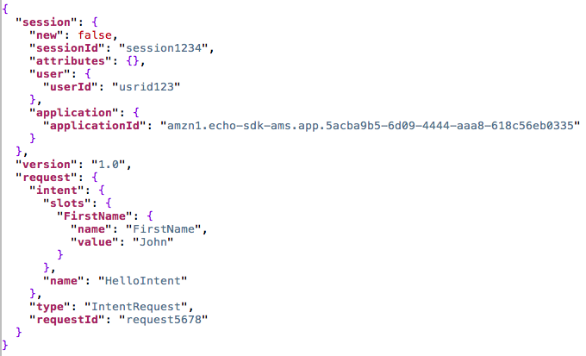
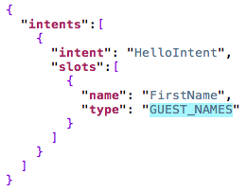
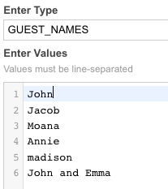
Alexa Request to Endpoint
ask greeter to say hello to John
ask greeter to say hello to John
Amazon Alexa Service
To
Endpoint
Developer Portal

Slide 20
AWS LAMDA FUNCTION Introduction and setup

Slide 21
AWS Lambda Introduction
AWS Lambda is a serverless compute service that runs your code in response to events and automatically manages the underlying compute resources for you.
AWS Free tier:
1,000,000 free requests per month
Up to 3.2 million seconds of compute time per month

Slide 22
AWS Lambda Advantages for developing Alexa skill
No Need to maintain own servers or compute resources.
No need of SSL certificate or verifying the incoming requests are coming from Alexa service itself.
AWS Lambda runs your code only when you need it and scales with your usage.
For most developers, the Lambda free tier is sufficient for the function supporting an Alexa Skill.
AWS Lambda supports Java, Node.js, C#, and Python code, with support for other languages coming in the future.

Slide 23
Request event to Lambda function
Alexa Service
AWS LAMBDA FUNCTION
(Node.js)

Slide 24
Node.js Quick Tutorial

Slide 25
What is Node js?
“Node.js is a JavaScript runtime built on Chrome's V8 JavaScript engine. Node.js uses an event-driven, non-blocking I/O model that makes it lightweight and efficient.”
JavaScript runtime environment, which allows us to run JavaScript on a computer/server
Library
Server tools and applications
REST APIs & Backend applications
Chat servers

Slide 26
AWS LAMDA FUNCTION CODING PART-I

Slide 27
AWS LAMDA FUNCTION CODING PART-II and DEPLOYING

Slide 28
improving greetings skill AND Local environment setup, TESTING

Slide 29
Ssml (Speech synthesis markup language) AND UPLOAD AUTOMATION

Slide 30
SESSIONS FEATURE and STANDARD BUILT-IN INTENTS

Slide 31
INCLUDING a CARD IN RESPONSE

Slide 32
DEBUGGING

Slide 33
TESTING using mocha TEST framework

Slide 34
GREETINGS SKILL USING WEB SERVICE AS AN END POINT

Slide 35
Request event to Web service
Alexa Service (JSON request)
Greetings Web Server (Python – Flask Framework)
Internet

Slide 36
Deploying the skill from local web server

Slide 37
HOSTING THE SKILL ON HEROKU

Slide 38
TESTING GREETINGS SKILL (Web service)

Slide 39
REQUIREMENTS OF web service AND FLASK-ASK

Slide 40
GREETINGS SKILL USING FLASK-ASK

Slide 41
Requirements for Your Web Service
Must support HTTP over SSL/TLS with valid trusted certificate.
Any request coming from other sources should be rejected.
Check the request signature to verify the authenticity of the request.

Slide 42
GREETINGS SKILL USING FLASK-ASK

Slide 43
FOOD NUTRITION LOOKUP SKILL - Introduction

Slide 44
Food Nutrition Lookup
Request: Alexa, ask “nutri lookup” ”how many calories are in <food item>”
Ex: Alexa, ask nutri lookup how many calories are in butter salted
Response: 100 grams of <food item> contain <number> calories.
Ex: 100 grams of butter salted contain 717 calories.

Slide 45
FOOD NUTRITION LOOKUP SKILL - SETUP

Slide 46
FOOD NUTRITION LOOKUP SKILL – CODING PART-1

Slide 47
FOOD NUTRITION LOOKUP SKILL – CODING PART-2

Slide 48
FOOD NUTRITION LOOKUP SKILL – TESTING

Slide 49
FOOD NUTRITION LOOKUP SKILL – DEPLOYING SKILL

Slide 50
FOOD NUTRITION LOOKUP SKILL – CERTIFICATION REQUIREMENTS

Slide 51
FOOD NUTRITION LOOKUP SKILL – CERTIFICATION REQUIREMENTS part-2

Slide 52
FOOD NUTRITION LOOKUP SKILL – CERTIFICATION REQUIREMENTS part-3

Slide 53
FOOD NUTRITION LOOKUP SKILL – IMPROVEMENTS

Slide 54
ACCOUNT LINKING INRODUCTION

Slide 55
Why Account Linking?
username/password
Apps (Android/iOS/Alexa skill)
Web Service
Apps (Android/iOS/Alexa skill)
Apps (Android/iOS/Alexa skill)
Services
API
Db (user info)
Authentication

Slide 56
Why Account Linking?
Username/password
Apps (Android/iOS/Alexa skill)
Web Service
Apps (Android/iOS/Alexa skill)
Apps (Android/iOS/Alexa skill)
Services
API
Db (user info)
OAuth

Slide 57
Account Linking
ability to connect the identity of the end user with a user in another system.
Web Service
Apps (Android/iOS/Alexa skill)
Core Logic
API
Db (user info)
Authentication

Slide 58
Account Linking
ability to connect the identity of the end user with a user in another system.
Web Service
Apps (Android/iOS/Alexa skill)
Core Logic
API
Db (user info)
OAuth

Slide 59
Account Linking
ability to connect the identity of the end user with a user in another system.

Slide 60
EMAIL CHECKER SKILL – ACCOUNT LINKING SETUP

Slide 61
EMAIL CHECKER SKILL – CODING

Slide 62
EMAIL CHECKER SKILL – VOICE PASSWORD AND DYNOMODB setup

Slide 63
eMAIL CHECKER SKILL – VOICE PASSWORD coding

Slide 64
eMAIL CHECKER SKILL – TESTING

Slide 65
eMAIL CHECKER SKILL – FORGOT PIN FUNCTIONALITY

Slide 66
END

